Slide 1
Ahmad Jaber
machine learning project

Slide 2
Video Games Sales (regression)
Name of dataset

Slide 3
The presentation is divided into several sections-:
Description of the data set
Dataset Cleaning
Dataset Analysis and visualization
Data preprocessing and preparation
Machine Learning Regression Models
Results
Conclusion

Slide 4
Description of the data set
Source: vgchartz.com
This dataset contains about 16500 samples
Features in dataset :-
Rank - ranking of overall sales
Name - the games name
Platform - platform of the games release (i.e., PC, PS4, etc.)
Year - year of the game's release
Genre - genre of the game
Publisher - publisher of the game
Na_sales - sales in north America (in millions)
Eu_sales - sales in Europe (in millions)
Jp_sales - sales in Japan (in millions)
Other_sales - sales in the rest of the world (in millions)
Global_sales - total worldwide sales.

Slide 5
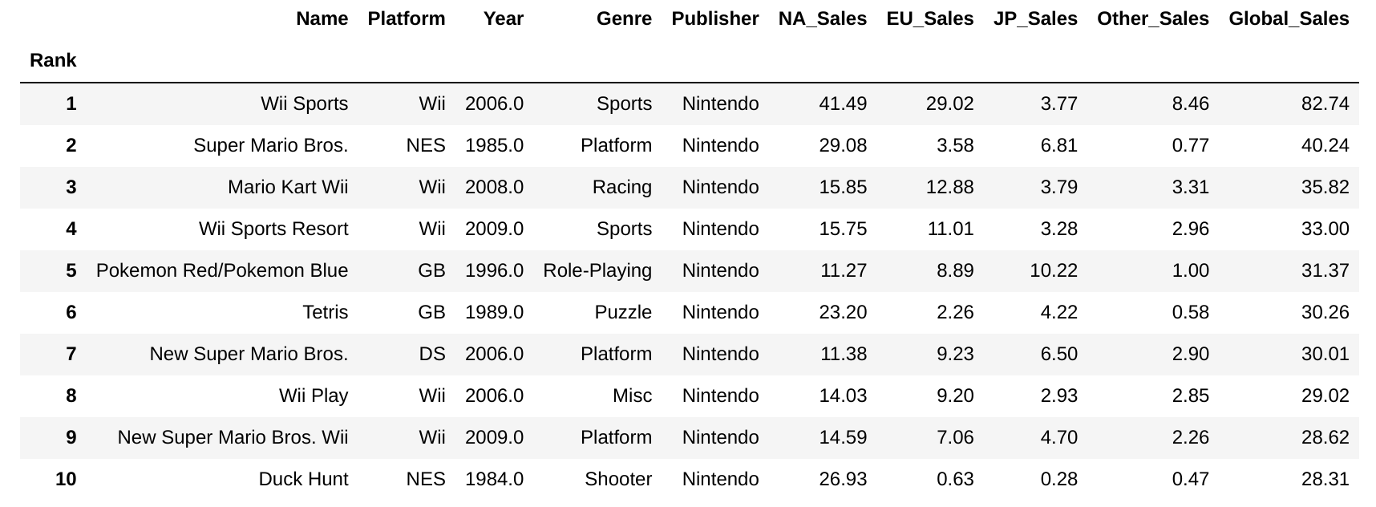
Dataset Cleaning
Dataset

Slide 6
Dataset Cleaning
Delete features that are not important.

Slide 7
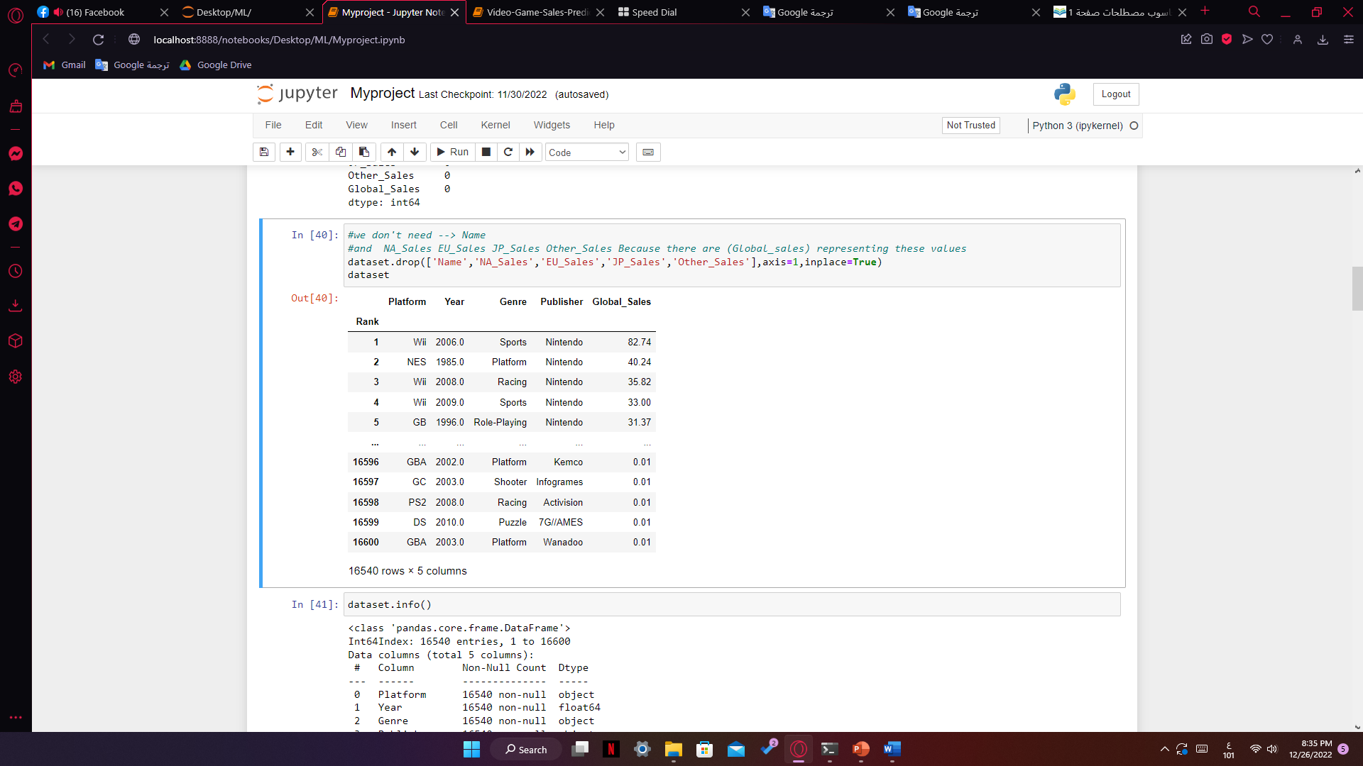
Dataset Cleaning
After Delete .

Slide 8
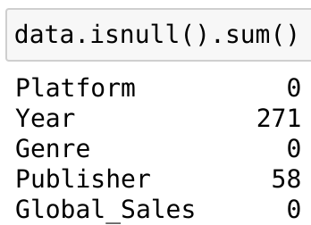
Dataset Cleaning
We checked the count of missing values in the dataset.
Fill in the missing values in “Year”.
Ignore the missing values in “Publisher”.

Slide 9
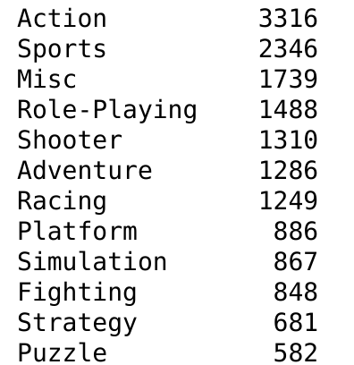
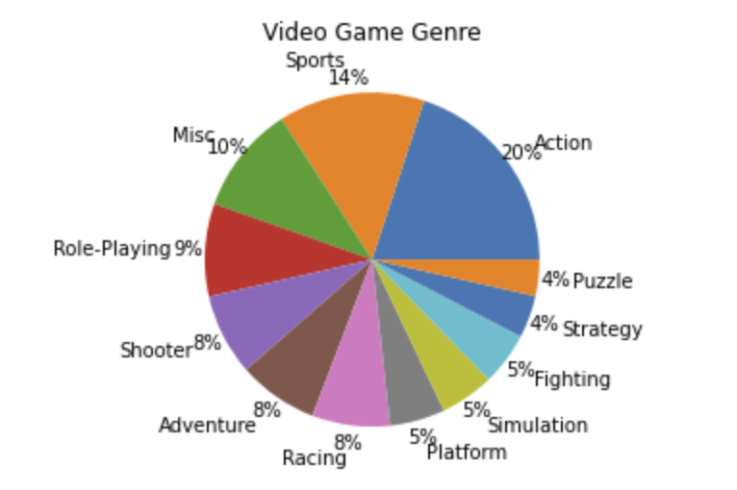
Dataset Analysis and visualization
Visualization for genre.

Slide 10
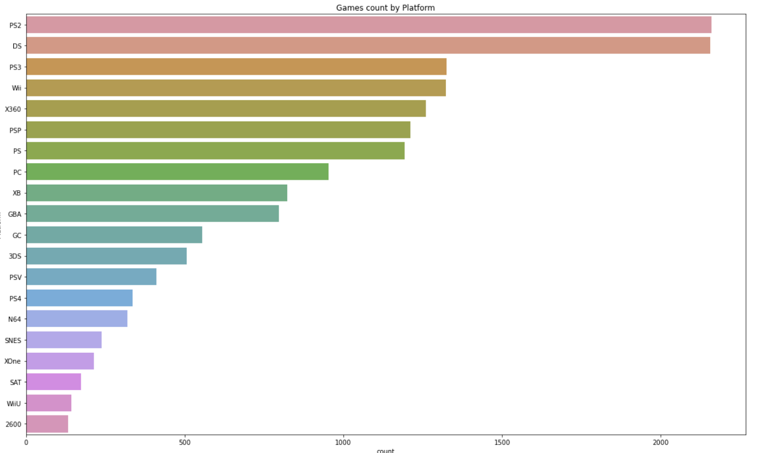
Dataset Analysis and visualization
Visualization for Platform.
Top 20 Platforms
We have around 30 unique platforms

Slide 11
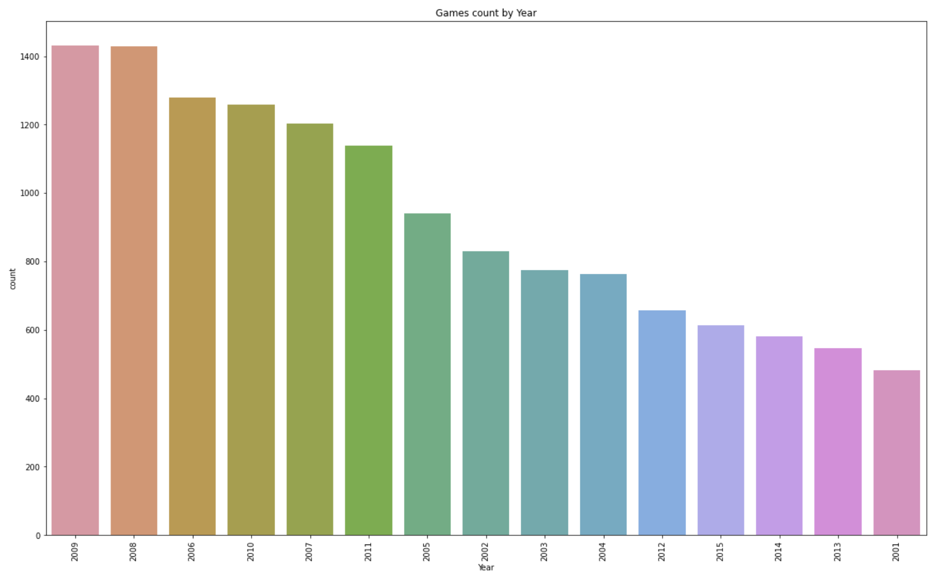
Dataset Analysis and visualization
Visualization for Year .
Top 15 Years
Data years ranges from 1980 - 2020

Slide 12
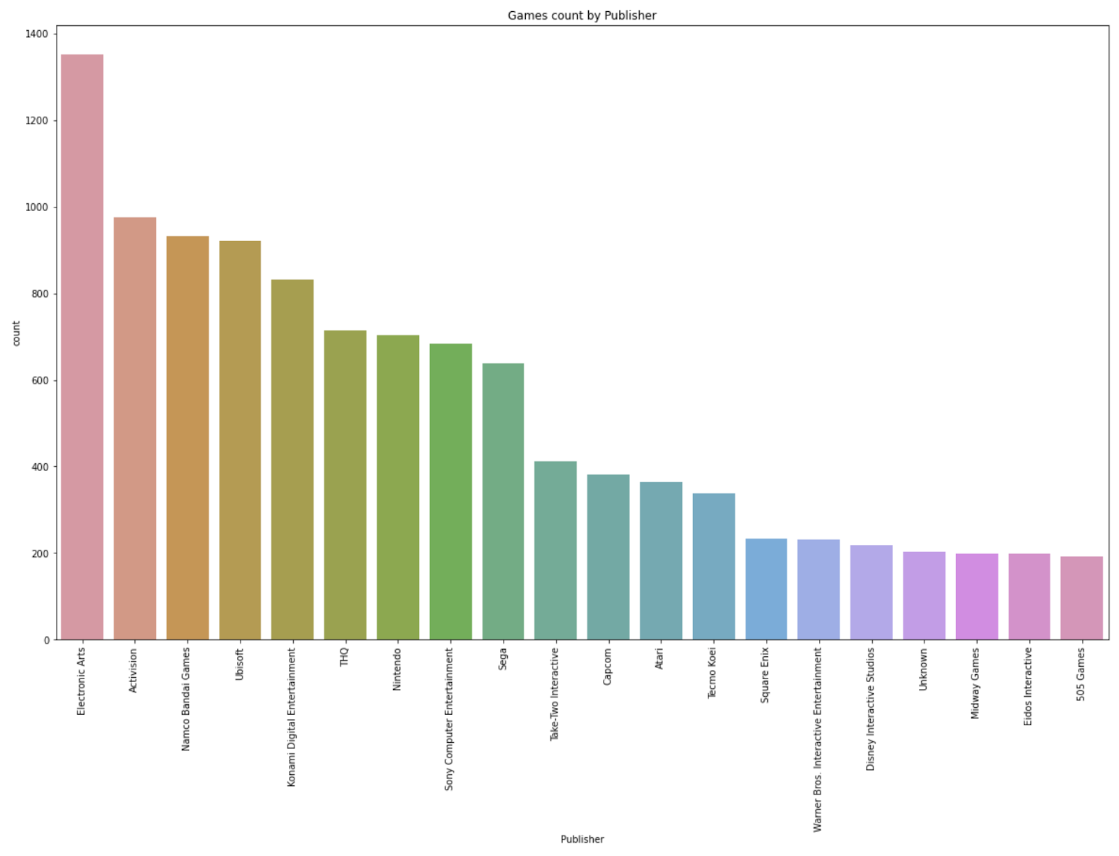
Dataset Analysis and visualization
Visualization for Publisher .
We only showed 20 publishers, because their number is about 600

Slide 13
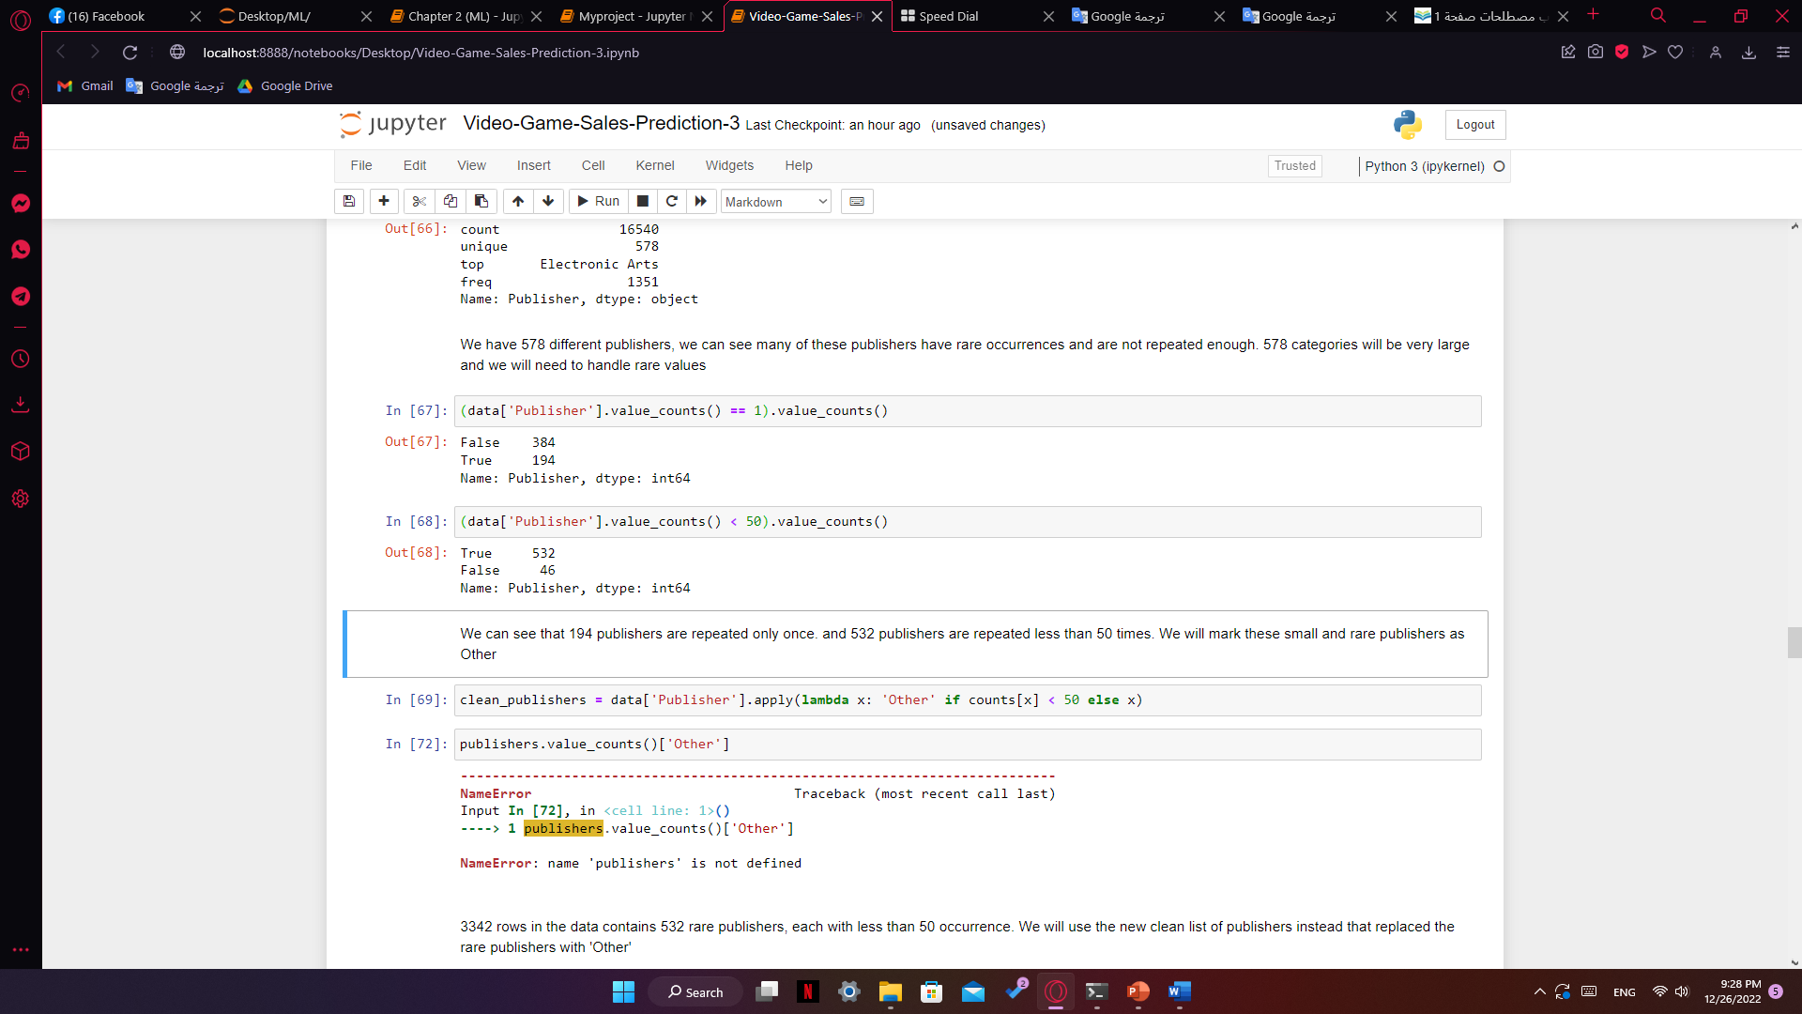
Data preprocessing and preparation
Solve the problem of publishers

Slide 14
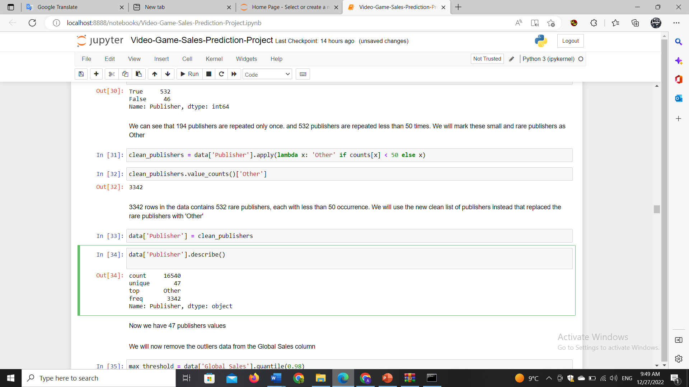
Data preprocessing and preparation
The result after preprocessing publishers

Slide 15
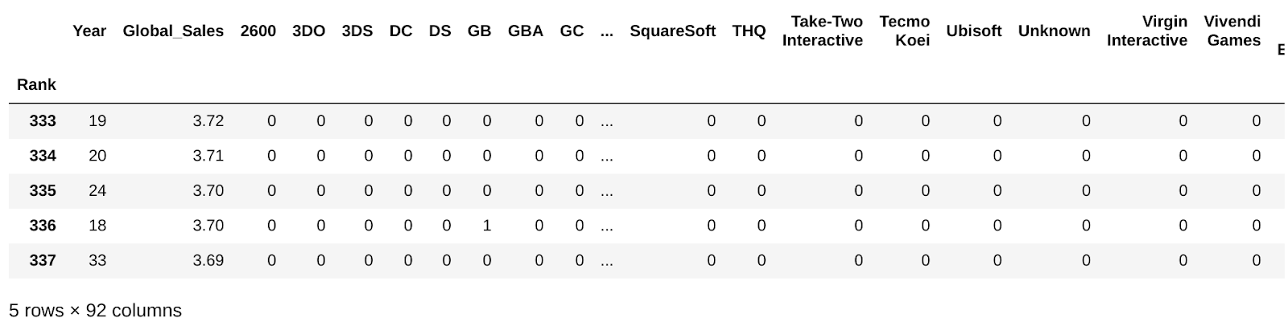
Data preprocessing and preparation
Encoding for the Categorical variables :
'Platform’
'Genre’
'Publisher’
Use onehot encoding

Slide 16
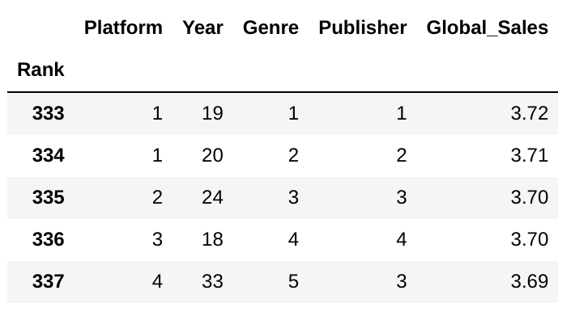
Data preprocessing and preparation
Encoding for the Categorical variables :
'Platform’
'Genre’
'Publisher’
Use ordinal encoding

Slide 17
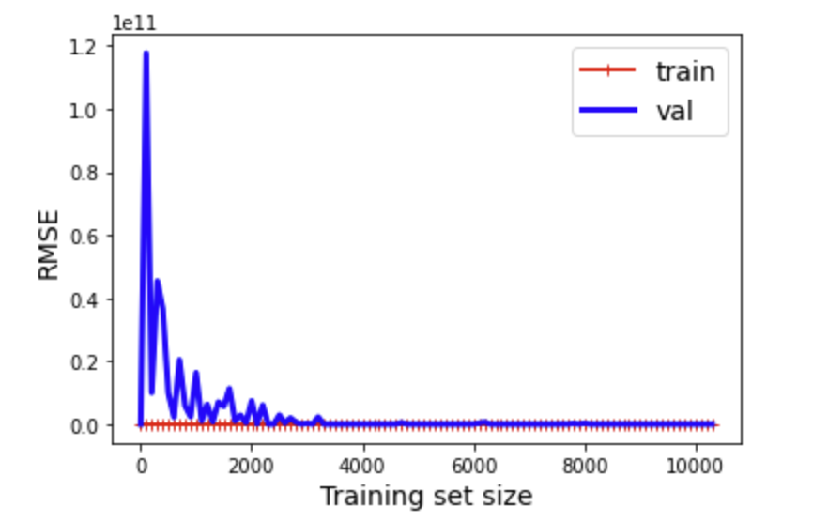
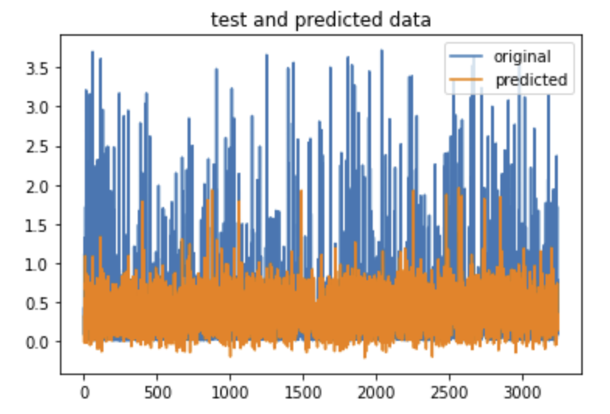
Machine Learning Models
Experiments with One Hot Encoded data:
Linear regression
Learning curve
Test and predicted data
Root mean squared error: 0.5219

Slide 18
Machine Learning Models
Experiments with One Hot Encoded data:
Polynomial regression
2 degrees
Training results:
Root mean squared error: 0.46
Testing results:
Testing Root mean squared error: 29443199.12

Slide 19
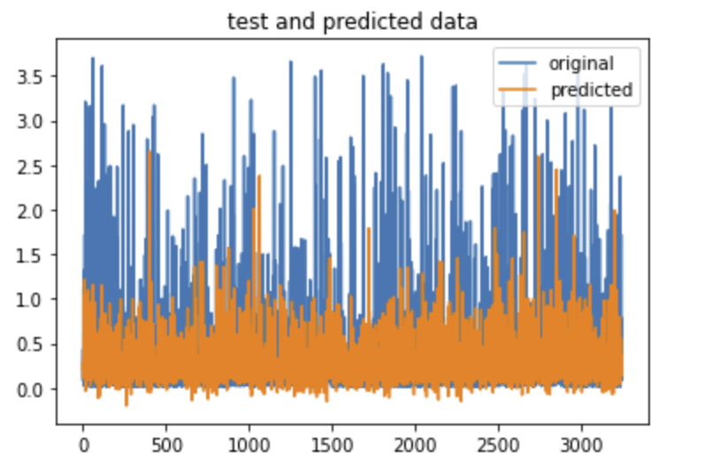
Machine Learning Models
Experiments with One Hot Encoded data:
Svm regression
Linear SVM:
Testing Root mean squared error: 0.52
SVR: Using randomized search with cross validation to find the appropriate hyper parameters:
Testing Root mean squared error: 0.52

Slide 20
Machine Learning Models
Experiments with ordinal Encoded data:
Linear regression: Testing Root mean squared error = 0.564
Polynomial Regression: Testing Root mean squared error = 0.553
Linear SVM: Testing Root mean squared error = 0.77

Slide 21
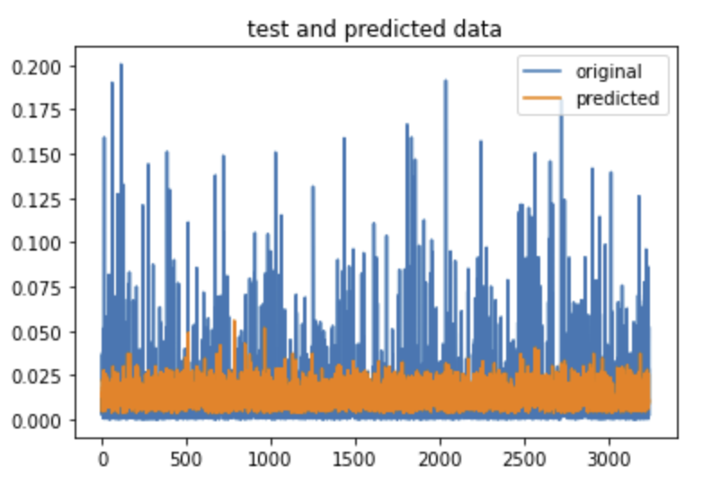
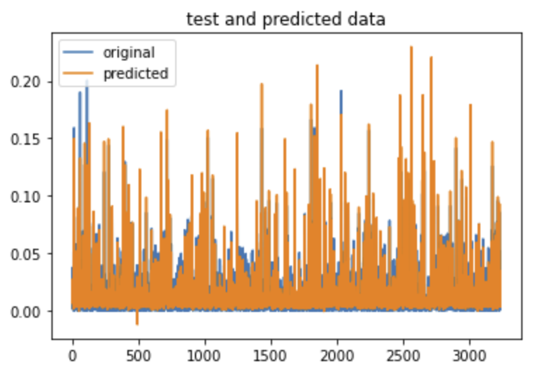
Machine Learning Models
Experiments with ordinal Encoded data + Normalization:
Linear regression: Testing Root mean squared error = 0.021
Polynomial Regression (4 degrees): Testing Root mean squared error = 0.0064
Linear SVM: Testing Root mean squared error = 0.02
Linear regression
Polynomial Regression

Slide 22
Conclusion
We got the best model by applying polynomial regression on ordinal encoded and normalized the data
Polynomial Regression

Slide 23
Thank you

